Slide 1
Human and Nonhuman Environments
Rice Cultures 2019

Slide 2
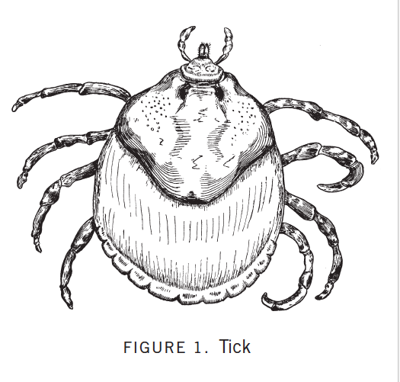

Slide 3
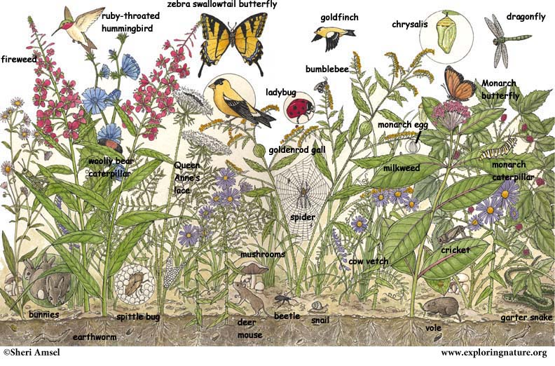

Slide 4
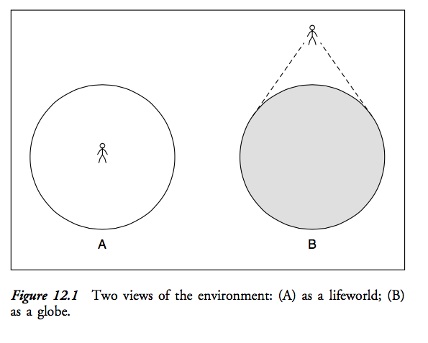
Two environments: Umwelt vs. globe
Source: Tim Ingold, Perception of the environment

Slide 5
Is human environment different from nonhuman environment?
What about culture?

Slide 6
Human behavior
“Culture is best not seen as complexes of concrete behavior patterns—customs, usages, traditions, habit clusters—but as a set of control mechanisms—plans, recipes, rules, instructions (what computer engineers call ‘programs’) for the governing of behavior.” (Geertz, 24)

Slide 7
“And out of such reformulations of the concept of culture and of the role of culture in human life comes, in turn, a deﬁnition of man stressing not so much the empirical commonalities in his behavior, from place to place and time to time, but rather the mechanisms by whose agency the breadth and indeterminateness of his inherent capacities are reduced to the narrowness and speciﬁcity of his actual accomplishments. One of the most signiﬁcant facts about us may ﬁnally be that we all begin with the natural equipment to live a thousand kinds of life but end in the end having lived only one.”

Slide 8
We have to eat food.
But what we understand as palatable and good food, is widely variable.

Slide 9
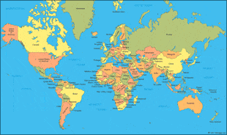
Not patterns of behavior. . .

Slide 10
But control mechanisms.
Human behavior
Feedback
Feedback
Model for
Cultural texts
Model of
Symbols

Slide 11
Nonhuman behavior
Self – environment interactions
Perception marks and effect marks

Slide 12
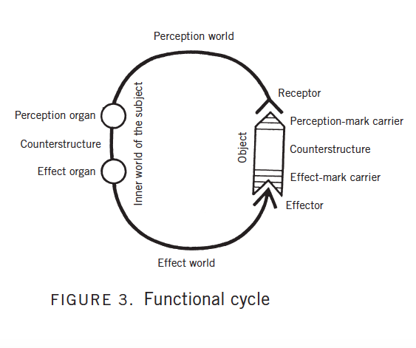

Slide 13
Geertz: a symbol is “words for the most part but also gestures, drawings, musical sounds, mechanical devices like clocks, or natural objects like jewels—anything, in fact, that is disengaged from its mere actuality and used to impose meaning upon experience.” (24).
Von Uexkull: signs and marks, perceptions and effects
What is similar and different about human and non-human organism-environment interactions?

Slide 14
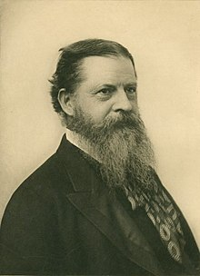
Charles Sanders Peirce
Semiotics –the study of signs

Slide 15
Pierce’s semiotics
Sign: “something which stands to somebody for something in some respect or capacity.”
Icon
Index
Symbol

Slide 16

Icon
Resemblance, likeness;
Isomorphic, to limit of identical
Requires ‘forgetting’ or ‘ignoring’ of aspects of non-identity
Words like ‘buzz’, 猫

Slide 17
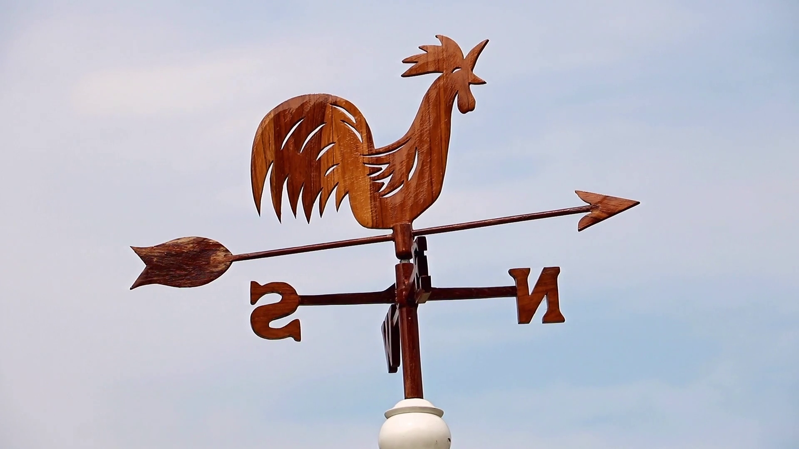
Index
Literally, ‘pointing’ towards something
“whose relation to their objects consists in a correspondence in fact” (Pierce’s definition)

Slide 18


Slide 19

Symbol
Arbitrary relation to reference
Conventional, within community
“refer to the object indirectly by virtue of the ways in which they relate systematically to other such symbols”
Words like “sheep” or “capitalism”
“We wanted something that was memorable but meaningless, so we could educate people as to what it means.” Charles Baldwin, Dow Chemical

Slide 20
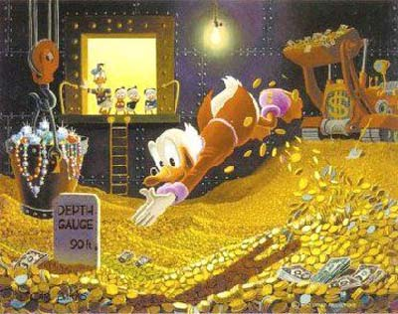
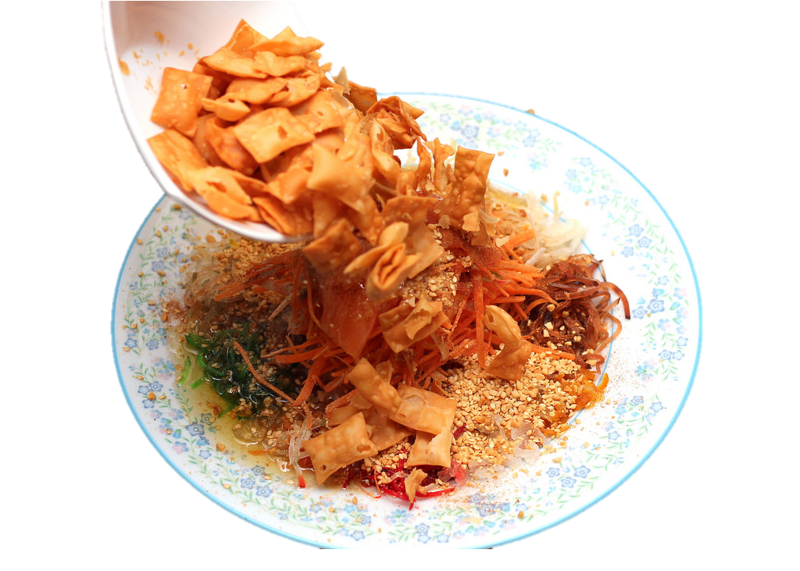

SHAPED LIKE
GOLDEN PILLOWS
“May the whole floor be filled with gold.”
满地黄金
Man Di Huang Jin

Slide 21

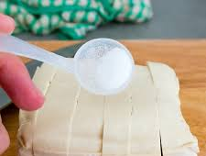
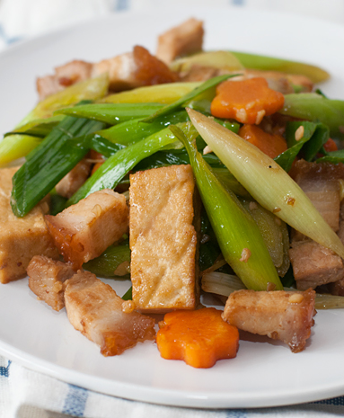
taukwa
I don’t know if other families do this, but it’s tradition for the first dish we eat to be taukwa because “jiak liao zoh kwa” in hokkien which means “eat this and become a court official” (in the past court officials are high ranking officers serving the emperor so in the modern era I guess it’s to signify us having success in work)
Leek with taukwa and pork
Leek in mandarin is “蒜” which rhymes with “算” which is count in mandarin – it’s symbolises us having a lot of money to count over the new year
These foods are homophones – words with the same sound but different meaning and this is especially littered across Chinese culture like numbers and actions.

Slide 22
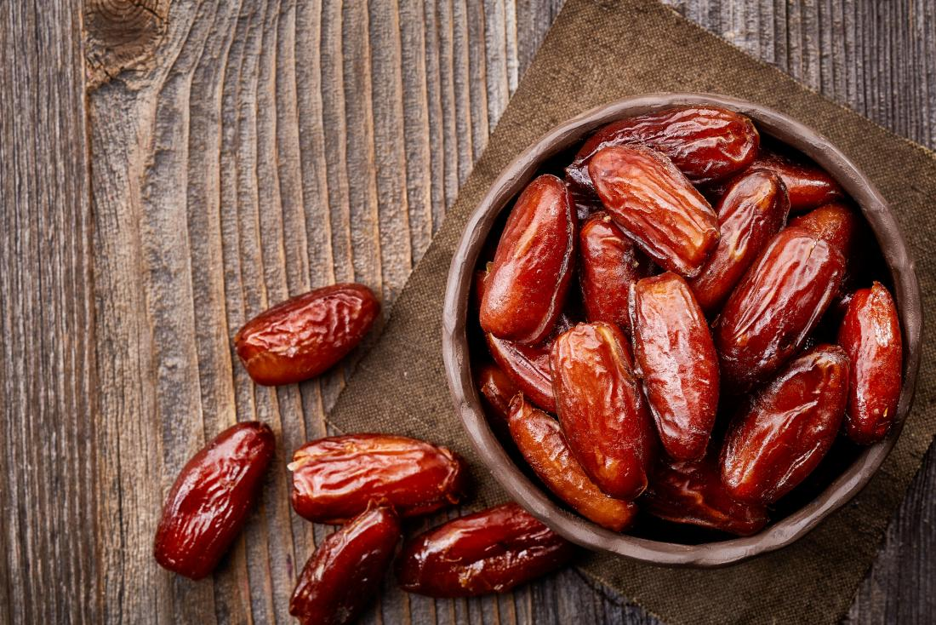
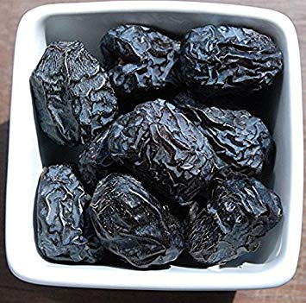
Date/Date palm in Islam
Dates are traditionally used during the month of Ramadan to break their fast.
The Prophet said: “Break your fast by eating dates as it is purifying”.
“Ajwa dates are from paradise and they are healing for possession.”
Ajwa dates were grown extensively in the Madinah region (Saudi Arabia)
They are very low in fat, contain vitamin A, B-complex vitamins and a host of other essential minerals.

Slide 23
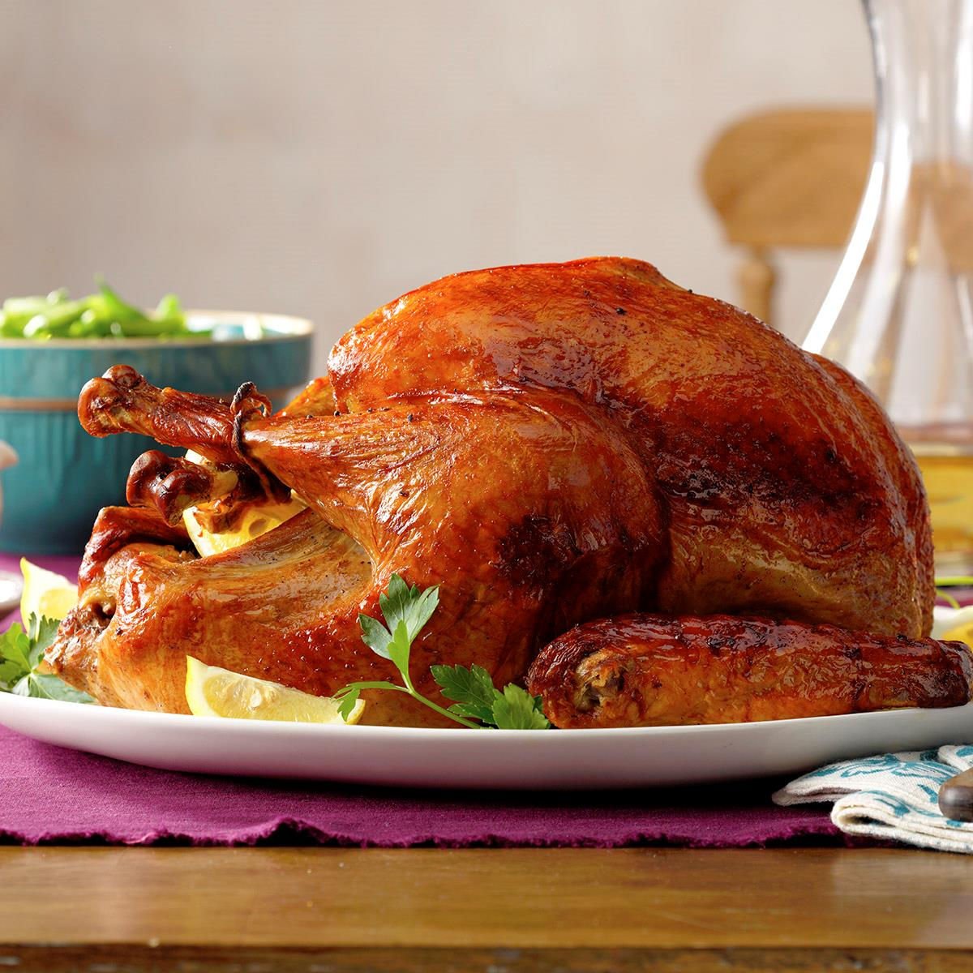
Thanksgiving Turkey

Slide 24
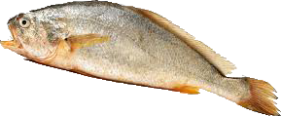
Salted Fish
Cultural Symbol of Hong Kong
Notes:
I hope to take some photos of that in the Chinatown; but due to the Chinese New Year, many of the stores are closed.

Slide 25
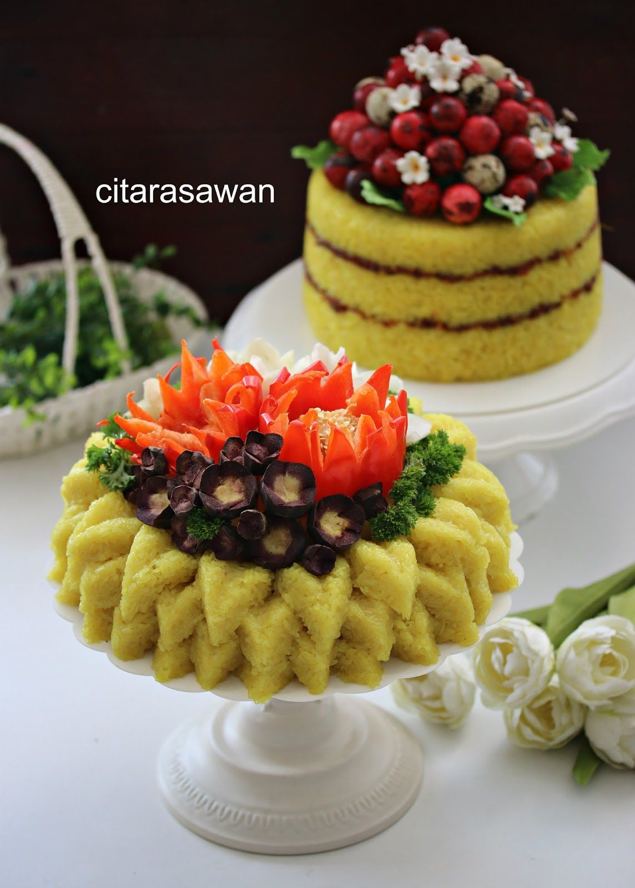
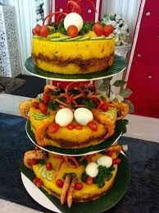
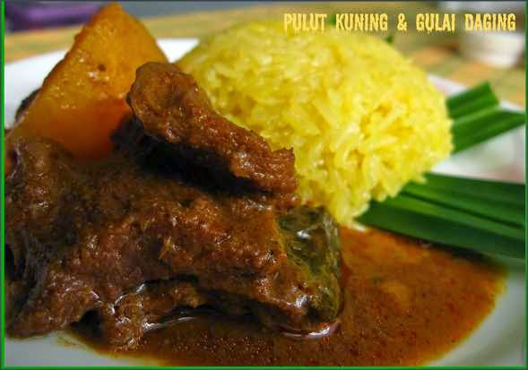
Pulut Kuning

Slide 26
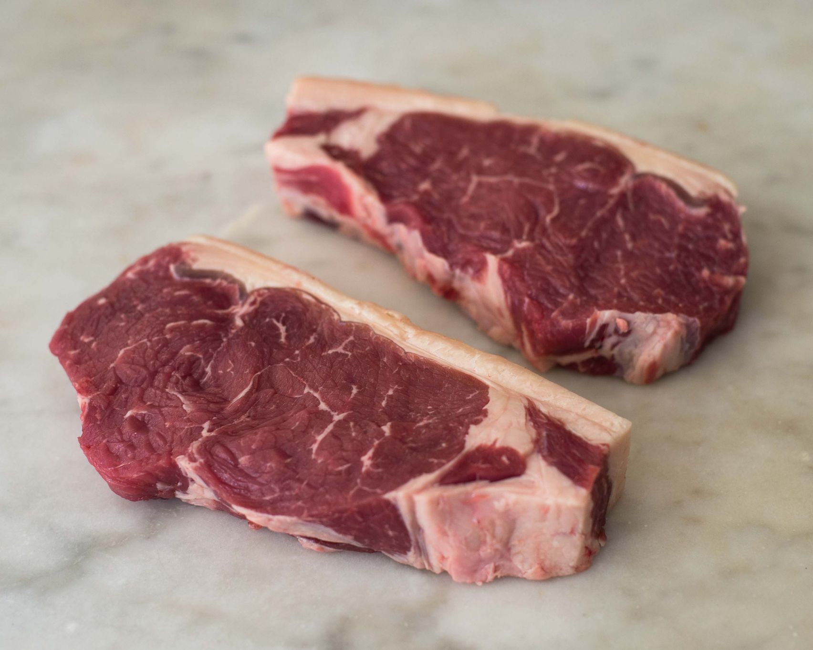

Slide 27
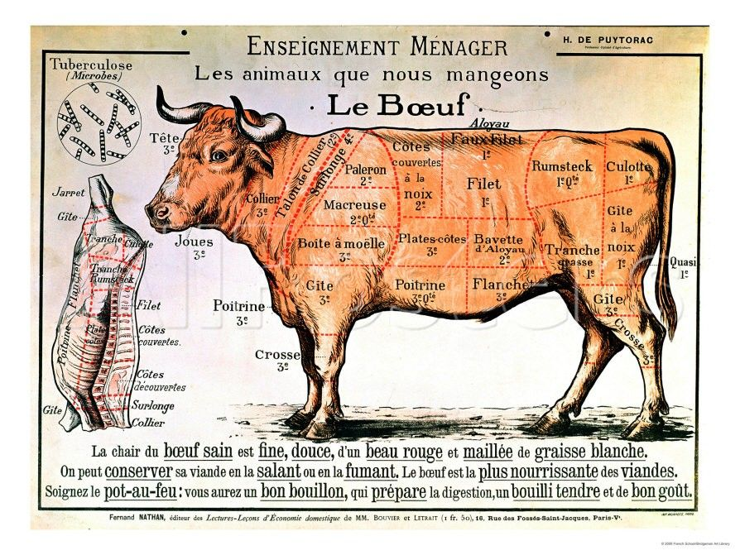
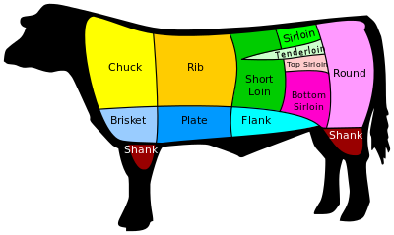

Slide 28
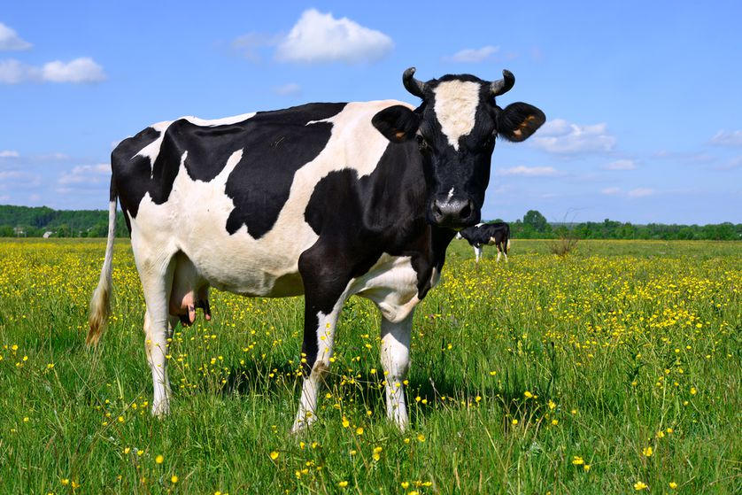
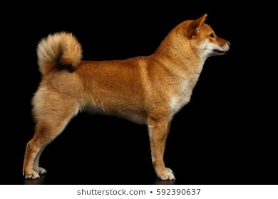
Food Taboos: the ’sacred’

Slide 29
Technology

Slide 30
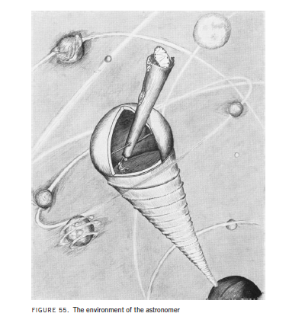
Von Uexkull, page 134

